Slide 1
MEANSHIFT ALGORITHM
CLUSTERING ALORITHMS

Slide 2
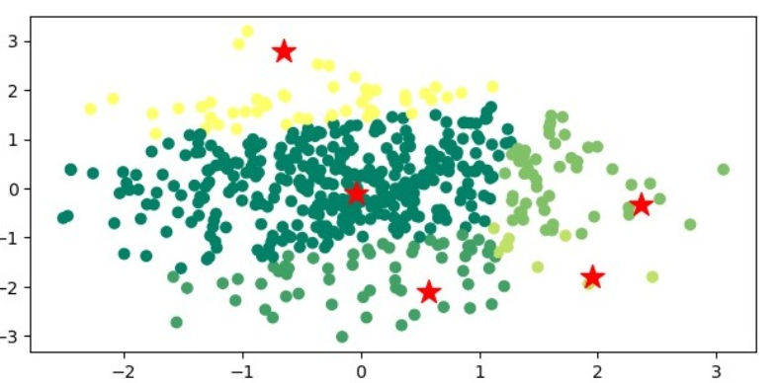
What is Mean Shift Clustering?
Definition: A clustering algorithm that identifies clusters by shifting points towards regions of higher density in feature space.
Key Features:
Does not require prior knowledge of the number of clusters.
Can find arbitrarily shaped clusters.
Key Concepts of Mean Shift Clustering
Kernel Density Estimation: Used to estimate the probability density function of the random variable.
Bandwidth: Determines the size of the window used to compute the density estimate.
Convergence: Points are iteratively moved to the mean of points in their neighborhood until convergence.

Slide 3
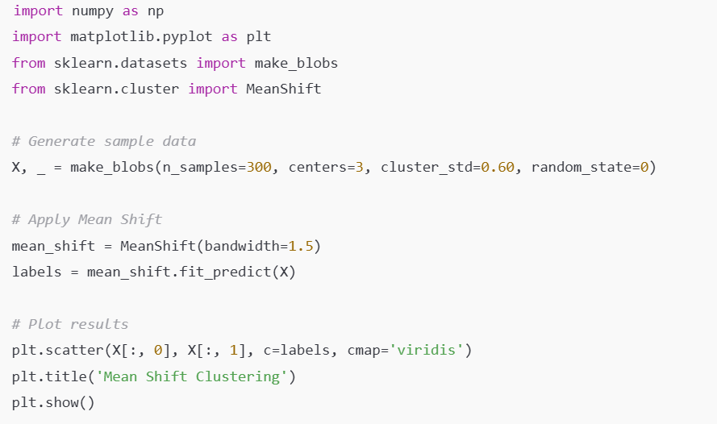
MEANSHIFT in scikit-learn
Examples:

